Slide 1
DOCKER CLI INSTALLATION

Slide 2
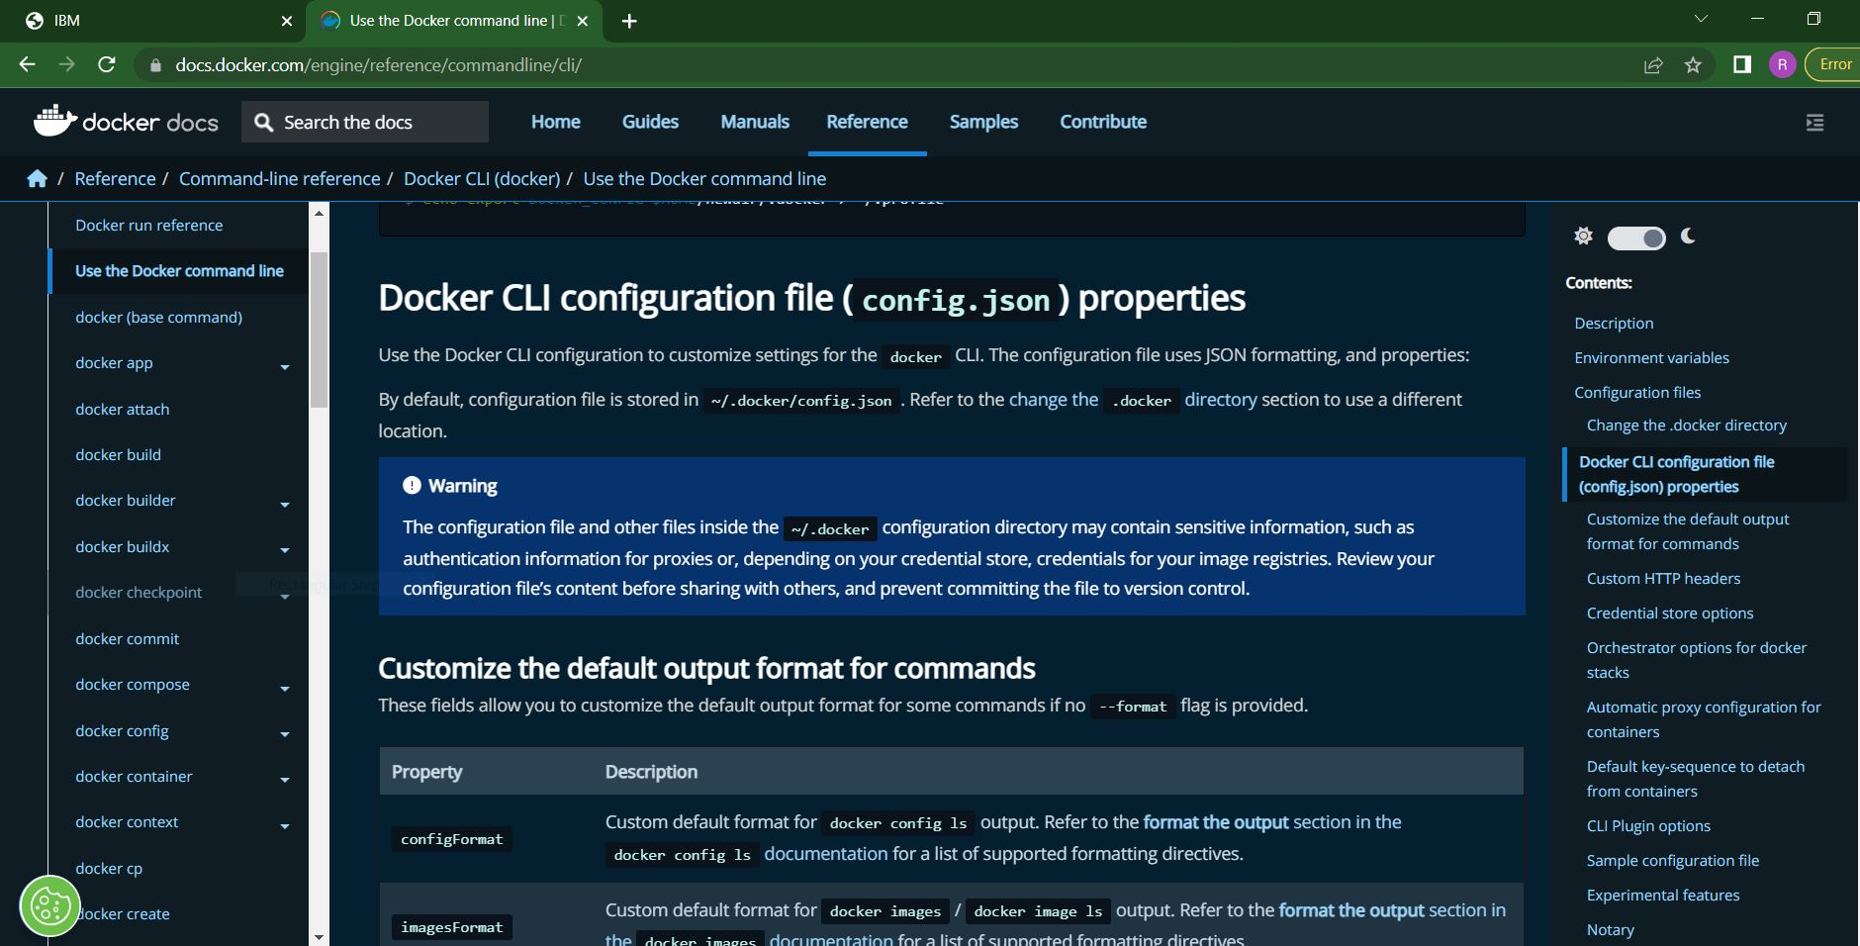

Slide 3
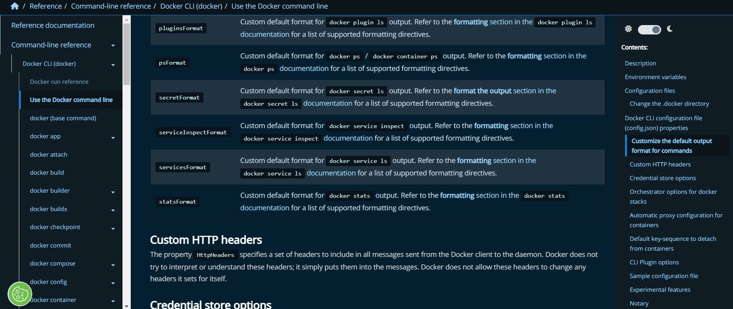

Slide 4
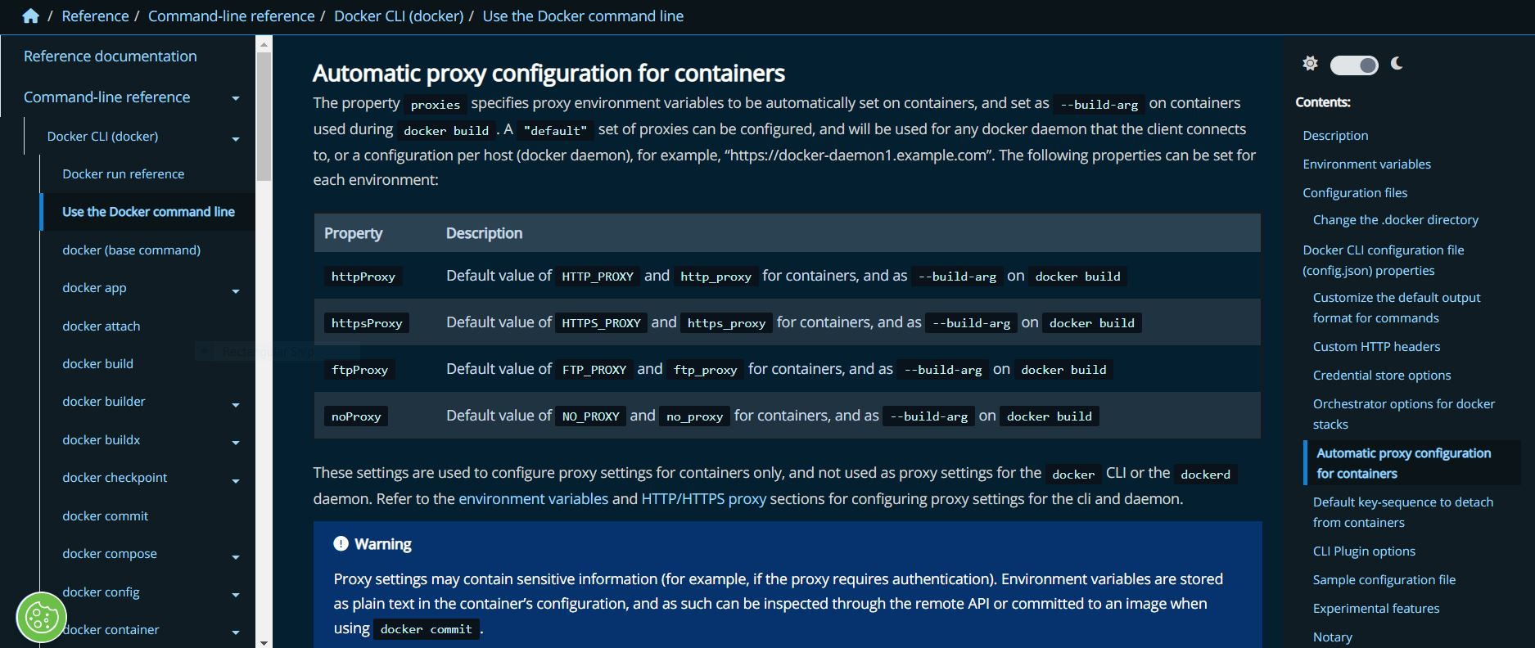

Slide 5
